Slide 1
SECURE DATA HIDING IN IMAGES USING STEGANOGRAPHY
CAPSTONE PROJECT
Presented By: Joel Mathew
Student Name : Joel Mathew
College Name : Bishop Speechly College for Advanced Studies, Pallom Kottayam
Department : BCA Department

Slide 2
OUTLINE
Problem Statement
Technology used
Wow factor
End users
Result
Conclusion
Git-hub Link
Future scope

Slide 3
Problem Statement
Traditional secure communication methods can be inefficient or easily detectable. Steganography allows hiding secret messages within images without noticeable changes. This project uses Python to embed and retrieve hidden text securely.
It enhances confidentiality by requiring a password for decryption.

Slide 4
Technology used
Programming Language: Python
Libraries: OpenCV (cv2), OS
Concepts: Image Processing, Pixel Manipulation, Cryptography Basics

Slide 5
Wow factors
Hides messages inside images without noticeable changes.
Requires a password for decryption, adding an extra security layer.
Simple and lightweight implementation.

Slide 6
End users
Individuals requiring secure communication.
Cybersecurity enthusiasts learning about steganography.
Developers exploring image-based encryption techniques.

Slide 7
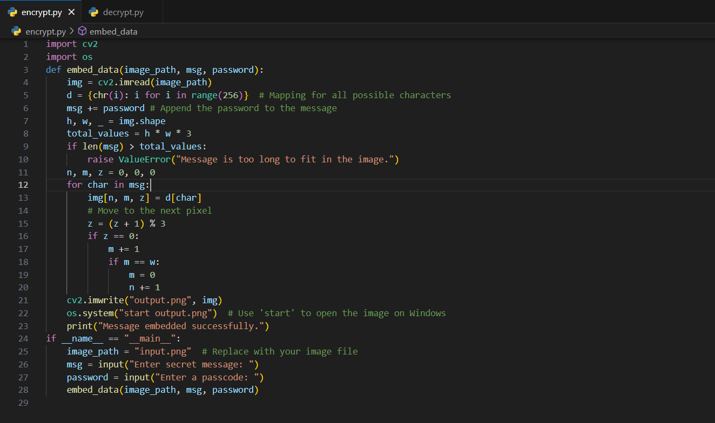

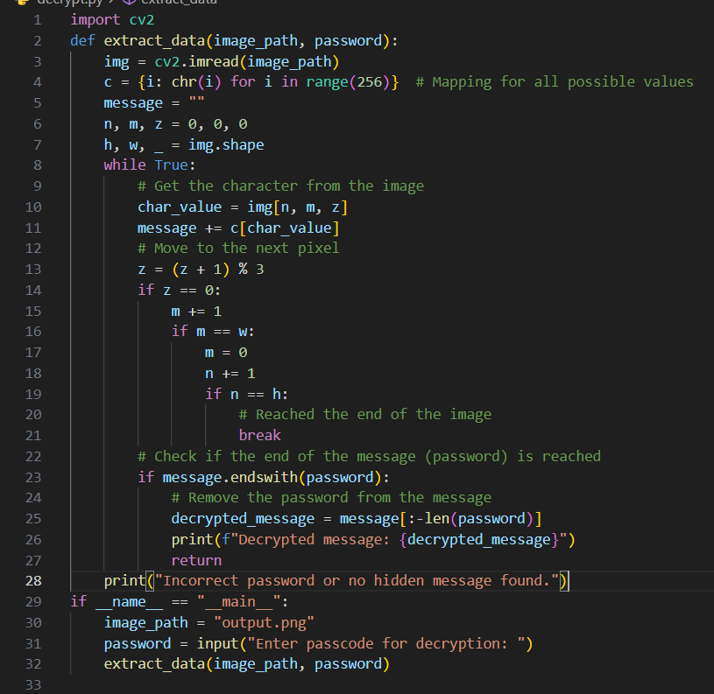

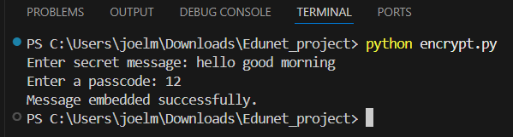
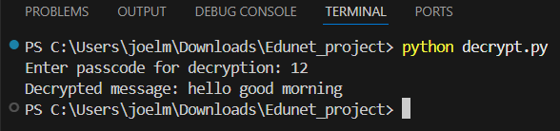
Results
Input
Output
Encryption
Decryption

Slide 8
Conclusion
Demonstrates a simple yet effective method for hiding messages inside images.
Password protection adds a security layer.
Can be expanded with advanced cryptographic techniques.

Slide 9
GitHub Link
https://github.com/johnwick077/AICTE-Internship-Edunet-foundation.git

Slide 10
Future scope(optional)
Improve security by using LSB Steganography or AES encryption.
Implement a GUI for ease of use.
Extend to audio/video steganography.

Slide 11
THANK YOU

